Slide 1
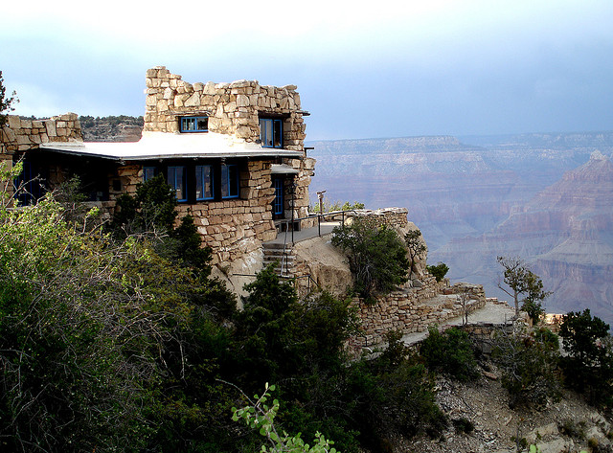
How's Your View?
1 Corinthians 4
Dr. Rick Griffith • Crossroads International Church Singapore
cicfamily.com & BibleStudyDownloads.org

Slide 2

Angels?
or Angles?

Slide 3
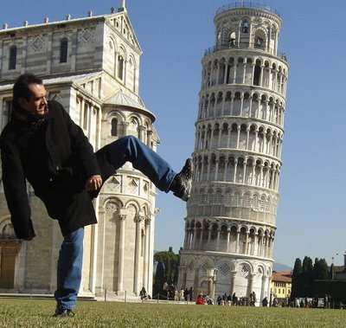
Angles: Pisa
Notes:
3

Slide 4
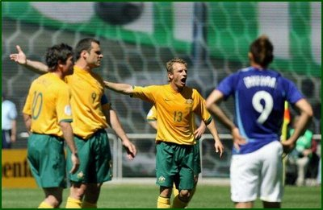
Angles: Long Arm Soccer
Notes:
4

Slide 5
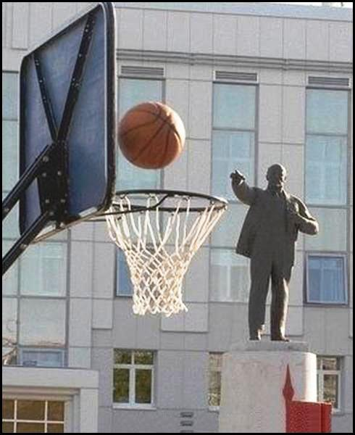
Angles: Lenin Swish
Notes:
5

Slide 6
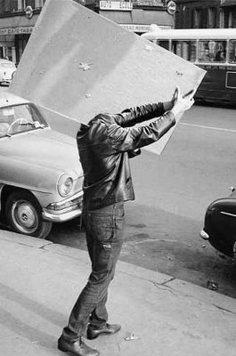
Angles: No Head
Notes:
6

Slide 7
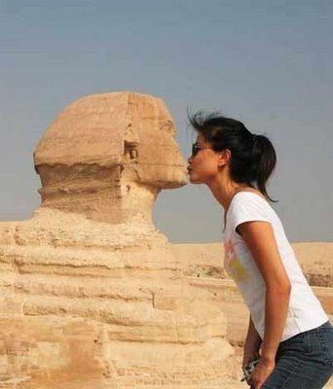
Angles: Kiss Sphinx
Notes:
7

Slide 8
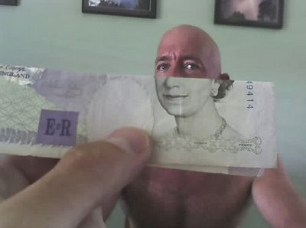
Angles: Bald Queen
Notes:
8

Slide 9

Leadership
Notes:
9

Slide 10
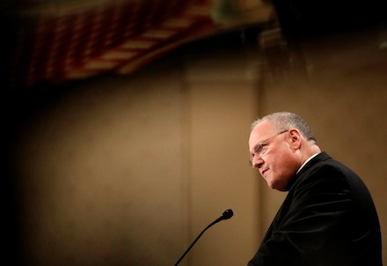
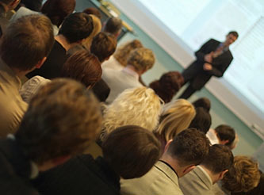
Church Leaders Today
Notes:
10

Slide 11
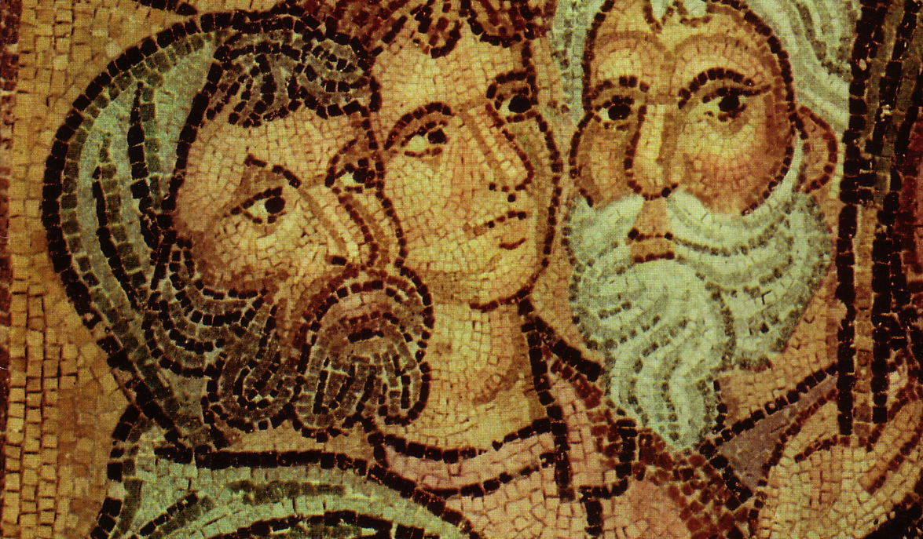
Parties at Corinth
P
A
P
Paul
Action
Party
Apollos
Yippee
Esquire
A
Y
E
C
T
E
Cephas
Triumphs
Esquire
S
D
P
Savior
Dvlpmnt
Party

Slide 12
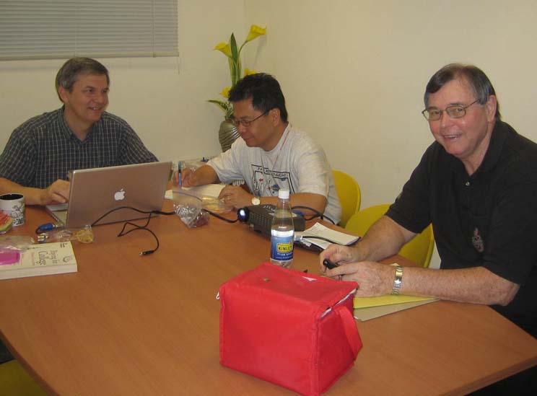
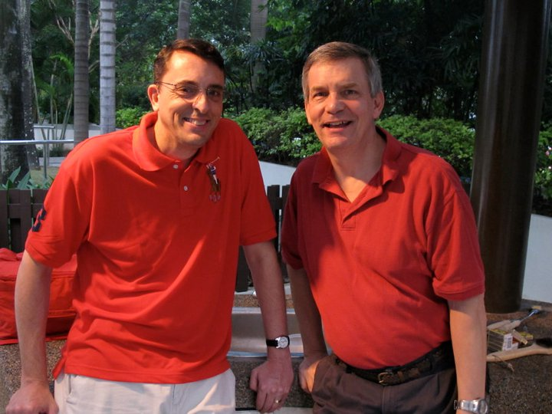
Today's Subject
How should we view our spiritual leaders?
Notes:
12

Slide 13
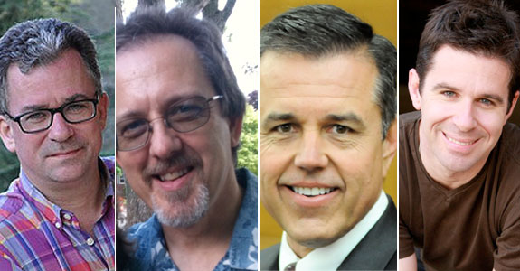
Why address leadership today?
Notes:
13
Lessons from Catholic Evangelists
August 22, 2012
Five prominent Catholic apologists share their methods of spreading the Good News and defending the Faith.
http://www.catholicworldreport.com/Item/1548/lessons_from_catholic_evangelists.aspx

Slide 14
Today's Subject
2 ways…
How should we view our spiritual leaders?
Notes:
14

Slide 15

I. Honor your leaders for their humility
(4:1-13)
Notes:
15

Slide 16

Humility (1-13):
Treat spiritual shepherds as faithful stewards accountable to God (1-5).
CEO
Christ Executive Officer
Notes:
16

Slide 17
Black
Notes:
17

Slide 18

Faithful Steward
Notes:
18

Slide 19
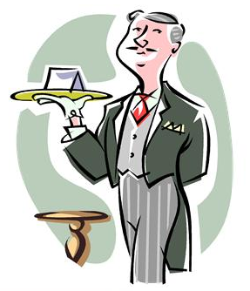
Faithful Steward
Notes:
19

Slide 20
Three Major Pastoral Leadership Tasks of Elders
Lead
Teach
1 Tim. 3:1, 4-5; 5:17
1 Tim. 3:2; 5:17
Pastor-Teachers
Episkopos =
Epi "over" +
skopos "look" =
"watch over"
Protect
1 Pet. 5:1-4
Acts 20:29, 35
1 Thess. 5:12
Eph. 4:11
Notes:
20

Slide 21
Humility (1-13):
Treat spiritual shepherds as faithful stewards accountable to God (1-5).
B. Evaluate elders by scriptural standards––not worldly ones (6-7).
Notes:
21

Slide 22
GODLY CHARACTER
1 Timothy 3:1-7; Titus 1:5-9

Slide 23
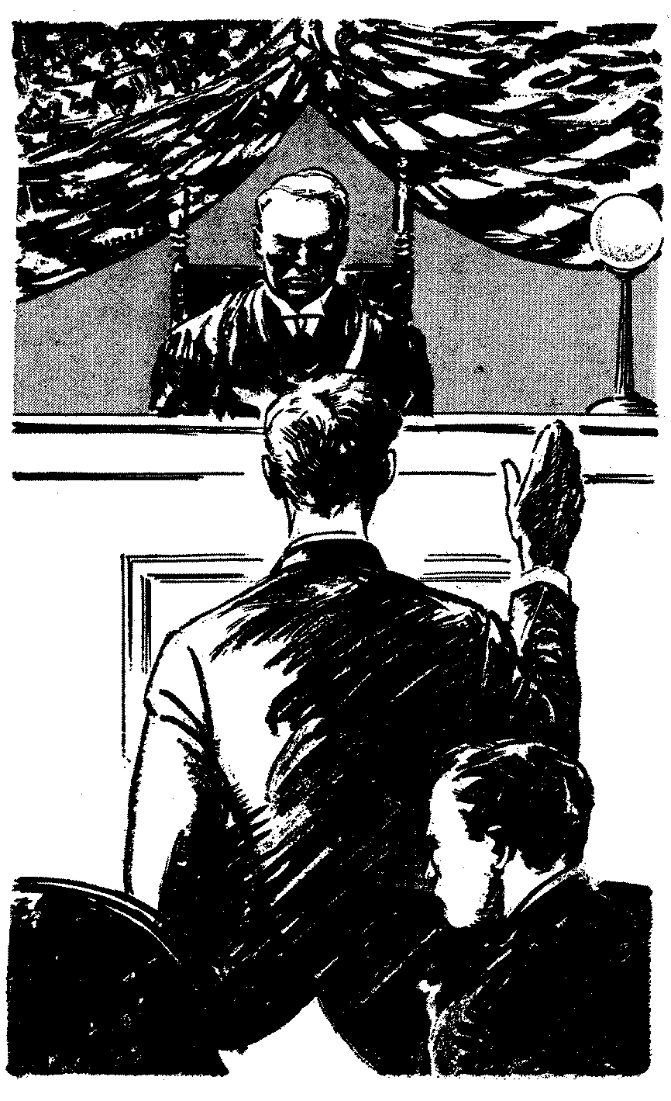
BLAMELESS
One against whom there is no legitimate charge of wrong doing in speech and actions.
Above reproach
Good reputation

Slide 24
Blamelessness is seen by others
BLAMELESS

Slide 25
HUSBAND OF ONE WIFE
Lit. "One-woman kind of man"
Culture: - sexual impurity
- divorce
Believers were "called out of"
Context: moral character

Slide 26
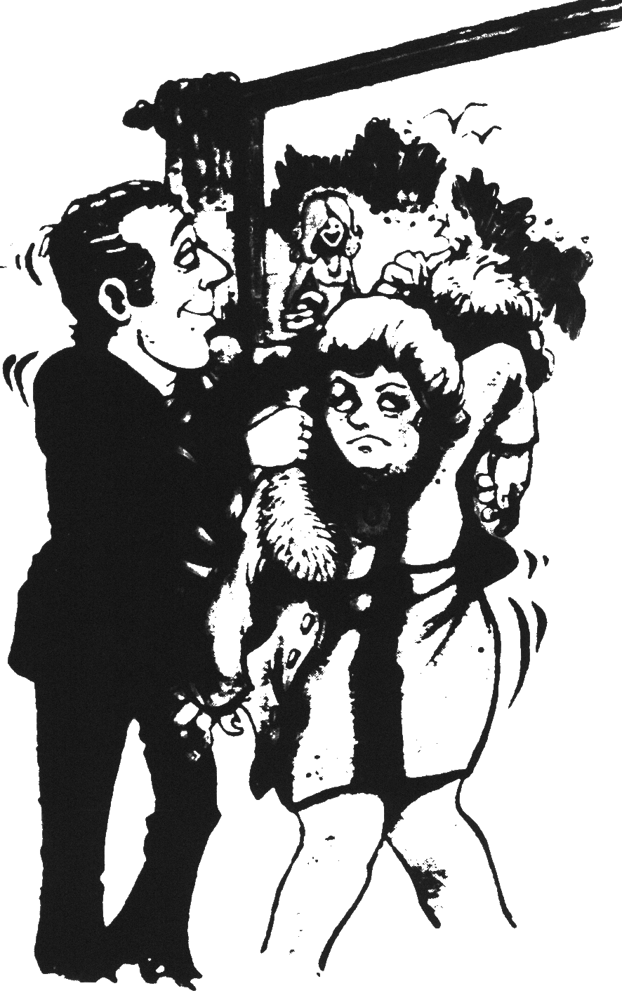
Lookin' again?

Slide 27
HIS CHILDREN
Children = child in his home
Believers
Under his control
1 Timothy 3:4 "he must manage his own family well and see that his children obey him with proper respect."

Slide 28
ENTRUSTED WITH
GOD'S WORK
Overseer - a guardian, one responsible for the spiritual welfare and governing of the church
Manager in God's household
GOD'S
WORK

Slide 29
NOT OVERBEARING
"Enjoy one's self"
Self-centered - wants things his way
Stubborn, always right
False teachers (2 Pet. 2:10)

Slide 30
NOT QUICK-TEMPERED
"To boil," soon angry
Causes:
- Selfishness
- learned by example
James 1:19-20, "… slow to become angry…"

Slide 31
NOT GIVEN TO DRUNKENNESS
"One who sits long at wine"
Fermented grape juice
Not intoxicated
In Scripture strong drink and drunkenness are forbidden

Slide 32
NOT VIOLENT
"Someone who is armed for battle"
A fighter - hits others with his fists and words
Controlling, quarrelsome

Slide 33
NOT PURSUING DISHONEST GAIN
"Not fond of silver"
Not greedy - the desire for more
1 Peter 5:2
Materialism is not his priority
Not a mercenary - serves for money

Slide 34
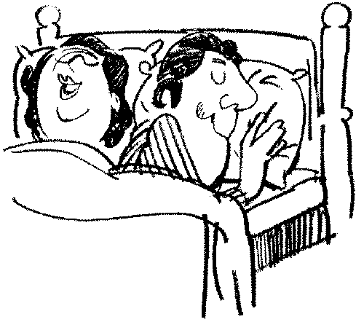
HOSPITABLE
One who is fond of strangers
Historically
- culture
- early church
Romans 12:13 - God's people
1 Peter 4:9 - no grumbling

Slide 35
ONE WHO LOVES
WHAT IS GOOD
One who loves and does what is beneficial and helpful to others
G
O
O
D
E
V
I
L

Slide 36
SELF-CONTROLLED
Sound mind, stable
Mind, emotions, and desires are under control
Balanced in his judgments
Humble (Rom. 12:3)

Slide 37
UPRIGHT
One who gives both men and God what is due them
Practical righteousness
Instinctive awareness of right and wrong
Joseph (Matt. 1:19)
GOD
MEN

Slide 38
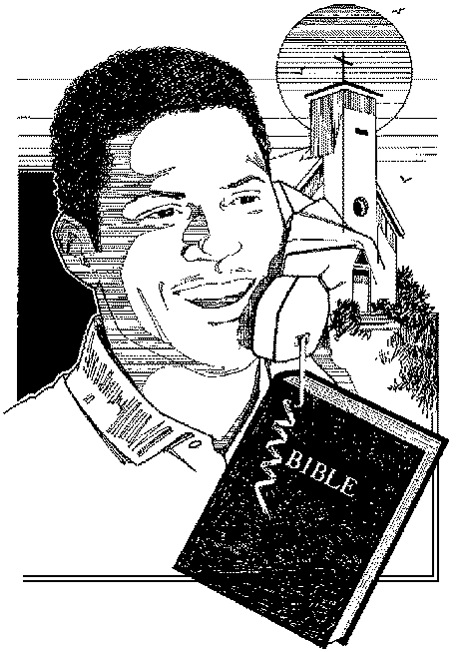
HOLY
Set apart for God
Position in Christ worked out in daily behavior
Becoming more like Christ
Hebrews 7:26
Ephesians 4:15 - 5:12

Slide 39
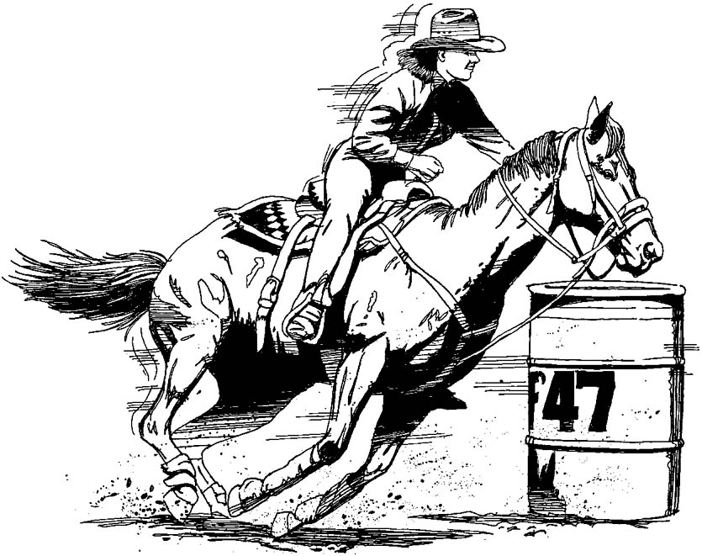
DISCIPLINED
Having power over, controlling
Exercising self-control
Not self-indulgent
Under the control of the Holy Spirit (Gal. 5:23)

Slide 40

Would Paul Pass?

Slide 41
Being biblical will protect the church from pride shown in comparing leaders (4:6b-7 NLT).
If you pay attention to what I have quoted from the Scriptures, you won’t be proud of one of your leaders at the expense of another. ⁷For what gives you the right to make such a judgment? What do you have that God hasn’t given you? And if everything you have is from God, why boast as though it were not a gift?

Slide 42
Black
Notes:
42

Slide 43
Humility (1-13):
Treat spiritual shepherds as faithful stewards accountable to God (1-5).
B. Evaluate elders by scriptural standards––not worldly ones (6-7).
C. Recognize your leaders' humble sacrifices to lead you (8-13).
Notes:
43

Slide 44
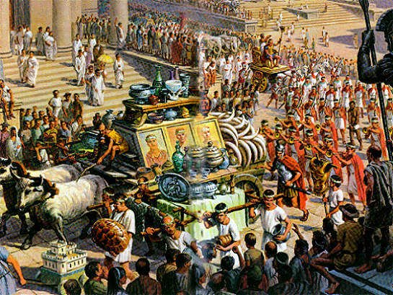
Roman Army Procession (4:9-13)
Notes:
44

Slide 45
I. Honor your leaders for their humility
(4:1-13)
Notes:
45

Slide 46
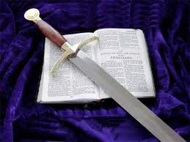
II. Respond to your elders' spiritual authority
(4:14-21)
Notes:
46

Slide 47
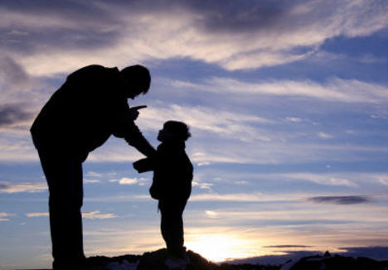
Fatherly Authority (14-21):
A. Fathers admonish (14-15).
Notes:
47

Slide 48

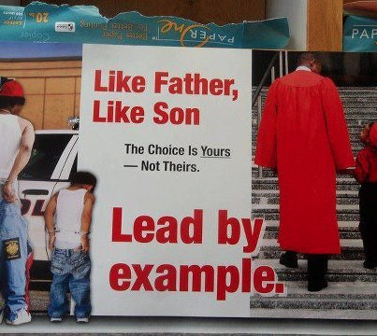
Fatherly Authority (14-21):
B. Fathers set an example of godliness (16-17).
Notes:
48

Slide 49
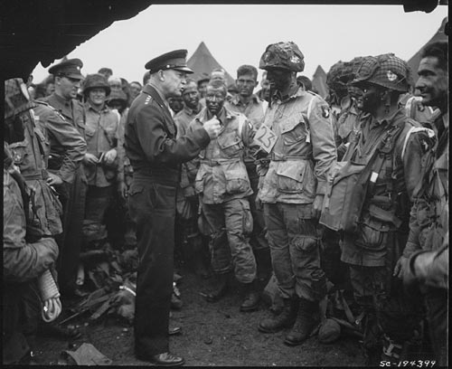
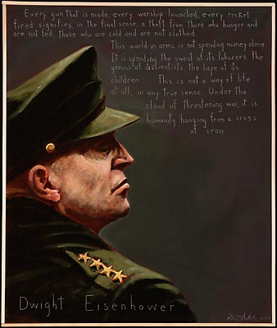
Dwight D. Eisenhower
(1890-1969)
Notes:
49

Slide 50
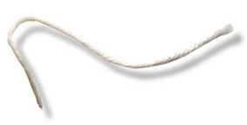
Pull your string
Notes:
50

Slide 51
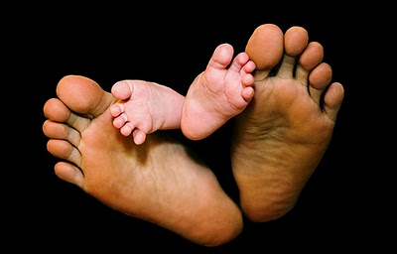
Fatherly Authority (14-21):
A. Fathers admonish (14-15).
B. Fathers set an example of godliness (16-17).
C. Fathers discipline stubborn kids
(18-21).
Notes:
51

Slide 52
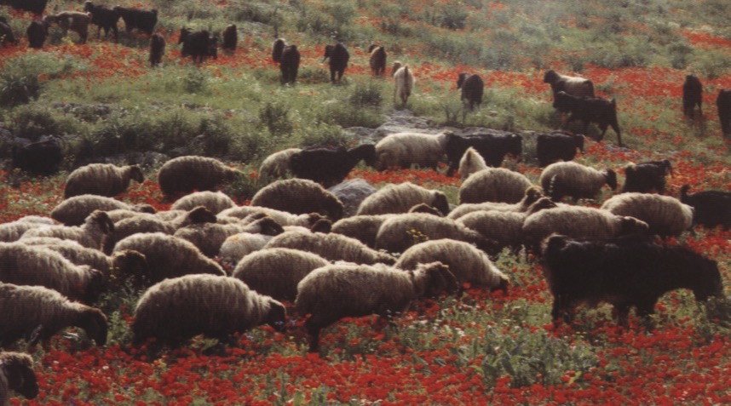
– Paul's Key Point –
Treat elders with a biblical balance––
as faithful and humble servants,
yet also as spiritual fathers with authority

Slide 53
Respect Leaders
1 Thessalonians 5:12-13
"Now we ask you, brothers, to respect those who work hard among you, who are over you in the Lord and who admonish you. Hold them in the highest regard in love because of their work. Live in peace with each other."
Notes:
53

Slide 54
Obey Leaders
Hebrews 13:17
"Obey your leaders and submit to their authority. They keep watch over you as men who must give an account. Obey them so that their work will be a joy, not a burden, for that would be of no advantage to you."
Notes:
54

Slide 55
Black
Notes:
55

Slide 56


NT Preaching link at BibleStudyDownloads.org
Get this presentation and script for free!
Notes:
NT Preaching (np)

